Slide 1
Simple Interest
Year 11 Essentials

Slide 2

Learning Outcomes
Calculate Simple Interest (2.2.4)
(Application of percentages)

Slide 3
Up – Talk – Down
Spend 60 seconds writing down all of the ways you can pay for things (including all the electronic payment methods)
When asked, everyone will stand up, take turns to say one of your items, and then sit down once you have had your turn to speak
Notes:
Have a general discussion with the class about paypal, afterpay, credit cards, debit cards, google pay, apple pay etc.

Slide 4

24
7
30
Simple Interest
Date: / /2018
EQ – How do I calculate Simple Interest if I don’t have a whole number of years?
I = P $×$ r $×$ t
I = Simple interest is money paid only on the principal.
P = Principal is the amount of money borrowed or invested.
r = Rate of interest is the percent charged per year or earned as a decimal. This is sometimes called a flat rate
t =Time that the money is borrowed or invested (in years).

Slide 5
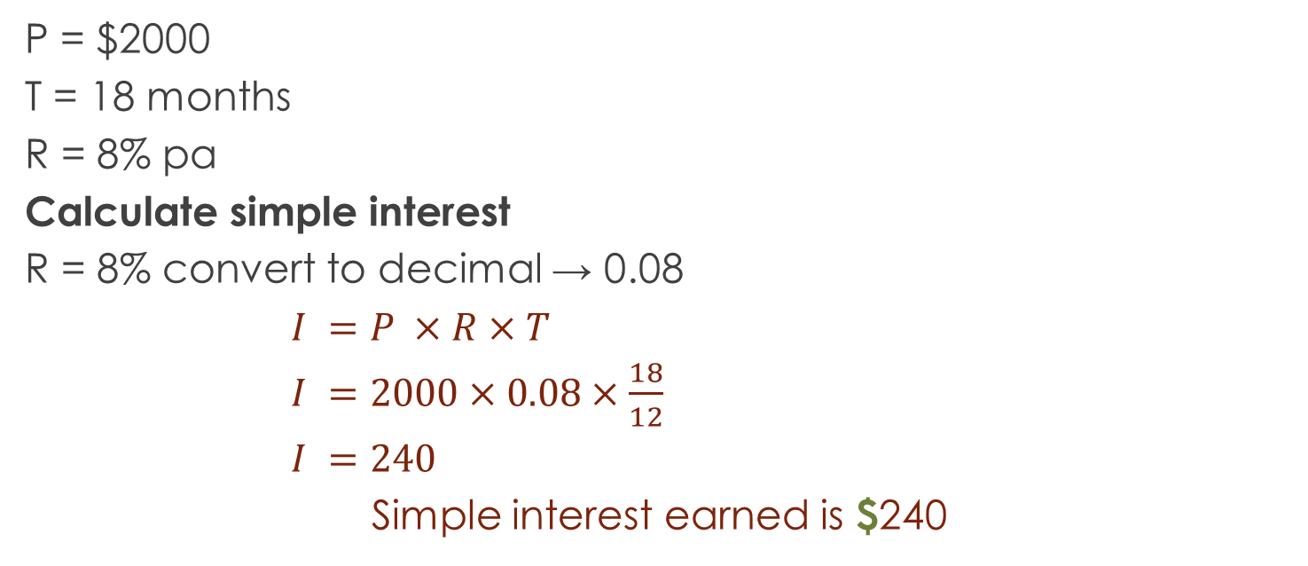
Let’s Try It Out
P = $2000
T = 18 months
R = 8% pa
Calculate simple interest
R = 8% convert to decimal → 0.08
$I =P ×R×T$
$I =2000×0.08×\frac{18}{12}$
$I =240$
Simple interest earned is $240

Slide 6
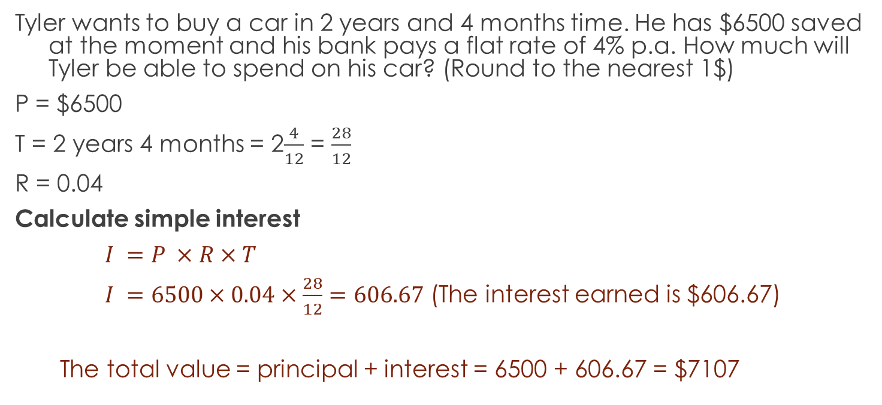
Let’s Try It Out
Tyler wants to buy a car in 2 years and 4 months time. He has $6500 saved at the moment and his bank pays a flat rate of 4% p.a. How much will Tyler be able to spend on his car? (Round to the nearest 1$)
P = $6500
T = 2 years 4 months = 2$\frac{4}{12}$ = $\frac{28}{12}$
R = 0.04
Calculate simple interest
$I =P ×R×T$
$I =6500×0.04×\frac{28}{12}=606.67$ (The interest earned is $606.67)
The total value = principal + interest = 6500 + 606.67 = $7107

Slide 7
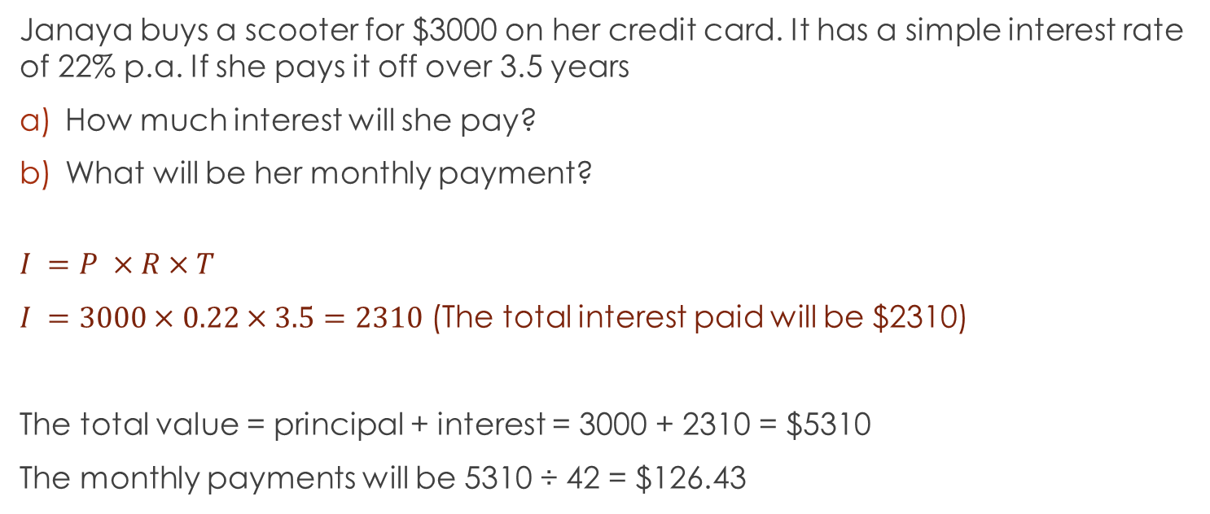
One More To Be Sure
Janaya buys a scooter for $3000 on her credit card. It has a simple interest rate of 22% p.a. If she pays it off over 3.5 years
How much interest will she pay?
What will be her monthly payment?
$$I =P ×R×T$$
$I =3000×0.22×3.5=2310$ (The total interest paid will be $2310)
The total value = principal + interest = 3000 + 2310 = $5310
The monthly payments will be 5310 ÷ 42 = $126.43

Slide 8
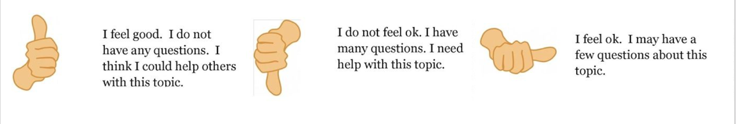
Check our understanding

Slide 9
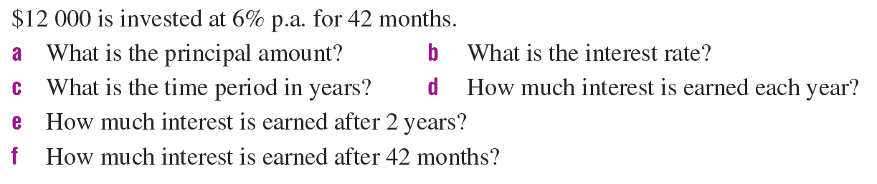
Calculate the Simple Interest

Slide 10
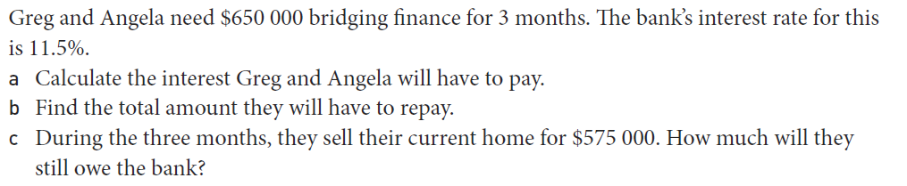
Task

Slide 11
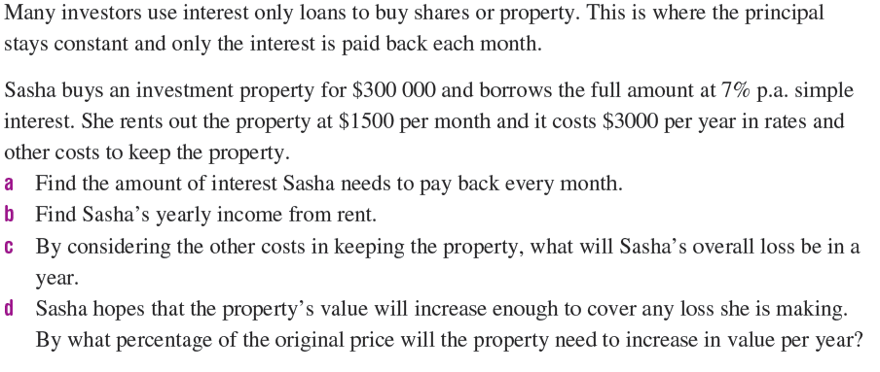
Task

Slide 12
HomeWORK
Complete your summaries
Add new terms to your glossaries
Write your questions
24, 7, 30

